Slide 1




Self-reported walking speed: a useful marker of physical performance among community-dwelling older people?
L Westbury¹, HE Syddall¹, C Cooper¹, A Aihie Sayer^{1,2}
¹ MRC Lifecourse Epidemiology Unit
² Academic Geriatric Medicine, University of Southampton of Southampton

Slide 2
Background
Slow measured walking speed among older people is a risk factor for disability, cognitive decline and mortality and a key component of the definitions for frailty and sarcopenia.
Guralnik first used measured walking speed in 1994 as part of a physical performance assessment.
Direct measurement of walking speed in epidemiological studies has become common.

Slide 3
Background
Measurement of walking speed requires:
  trained observers
  strict measurement protocol
  face-to-face contact with participants
  physically able participants
  space to set up a walking course
Self-reported walking speed could be a useful alternative.

Slide 4
Objectives
To investigate whether self-reported walking speed is associated with measured walking speed
To investigate whether self-reported and measured walking speed are similarly associated with various clinical characteristics and mortality

Slide 5
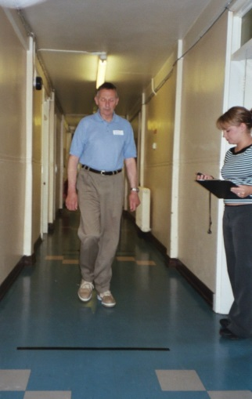
Methods
We used data from 730 men and 999 women who participated in the Hertfordshire Cohort Study (HCS).
Walking speed at customary pace was measured over 3 metres.
Self reported walking speed was obtained by asking participants to rate their walking speed as:
  unable to walk
  very slow
  stroll at an easy pace
  normal speed
  fairly brisk
  fast

Slide 6
Methods
Cross-sectional associations between clinical characteristics and self-reported and measured walking speed at baseline were examined.
Clinical characteristics included:
  Hypertension
  Ischaemic heart disease
  Fracture history
  Diabetes
  Bronchitis
  Poor physical function
  Number of systems medicated

Slide 7
Methods
Longitudinal associations between self-reported and measured walking speed and mortality outcome were examined.
This analysis adjusted for:
  Age
  Height
  Weight
  Age left education
  Smoking history
  Alcohol consumption

Slide 8
Results: participant characteristics

Slide 9
Results: measured walking speed according to self reported walking speed

Slide 10
Results: associations with clinical characteristics
Clinical characteristic | Men |  | Women
 | Measured | Self reported | Measured | Self reported
Hypertension | ✓ | ✓ | ✓ | ✓
Ischaemic heart disease | ✗ | ✓ | ✓ | ✓
Fracture history | ✗ | ✗ | ✗ | ✗
Diabetes | ✓ | ✓ | ✗ | ✓
Physical function | ✓ | ✓ | ✓ | ✓
Bronchitis | ✗ | ✓ | ✗ | ✗
Number of systems medicated | ✓ | ✓ | ✓ | ✓

Slide 11
Results: 10 year mortality according to walking speed

Slide 12
Key findings
Self-reported walking speed was strongly associated with measured walking speed.
Self-reported and measured walking speeds were similarly associated with clinical characteristics and mortality among men and women who participated in HCS.

Slide 13
Discussion
Strengths
Weaknesses
Data obtained from large cohort and were rigorously collected
Participants comparable with those in the Health Survey for England - results are generalisable (Syddall et al., 2005).
Analysis adjusted for potential confounders
Healthy participant effect
According to protocol, a small number of HCS men (n=37) and women (n=32) who completed the 3 metre walk test with the use of an assistive device were excluded from the analysis.

Slide 14
Conclusion
First study to investigate whether self-reported walking speed is a useful marker of measured walking speed.
Results require replication, particularly among groups of older men and women in whom frailty and the use of assistive devices is likely to be greater.
Self-reported walking speed could serve as a useful marker of physical performance when direct measurement of walking speed is not feasible.

Slide 15
Acknowledgements
Study participants
Hertfordshire GPs
Hertfordshire Cohort Study Team
Dr Holly Syddall, Prof Avan Aihie Sayer and Prof Cyrus Cooper
Funding:
  Medical Research Council
  University of Southampton UK

